Slide 1
Focused General Plan Update Circulation & Mobility
City Council
January 14, 2020

Slide 2
Process
Vision and Existing Conditions
Draft General Plan
CEQA and Final General Plan
Community Visioning
White Papers
Vision & Opportunities
Mobility
Environmental Justice
Climate Adaptation
Complete
City Council Work Sessions: September 2019 - January 2020
Vision: Focused Updates
Environmental Justice & Climate Adaptation
Mobility
Public Draft General Plan: Spring/Summer 2020
Initial Study/Negative Declaration
City Council Hearings: Summer 2020
Final General Plan

Slide 3
Circulation Element Topics
The Circulation Element will address the following topics :
Oakley’s Mobility Goals, Policies & Programs
Citywide Transportation Plan
Roadway Classifications & Street Design Standards
Bicycle, Motor Vehicle, Pedestrian & Transit
Regional Connections
Future Improvements
Consistency with other General Plan elements
State law requirements

Slide 4
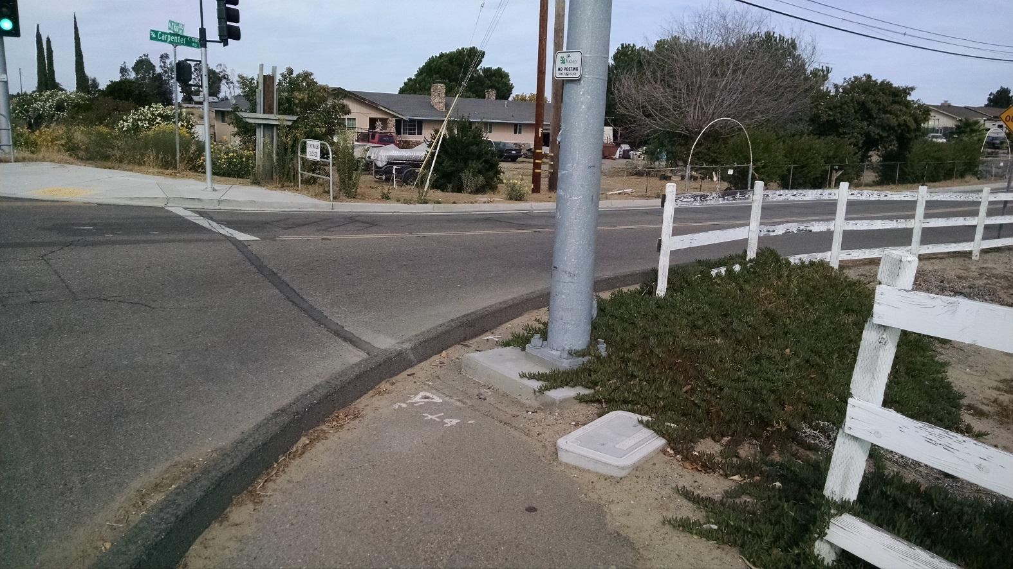
Circulation Element Update
Changes to State requirements & performance measures
Complete Streets
Vehicle Miles Traveled
Land Use, Mobility & Employment Trends
Update Mobility Vision & Multi-modal Priorities

Slide 5
Complete Streets Act
Complete Streets Act
The term “Complete Streets”
refers to a balanced, multimodal
transportation network that
meets the needs of all users of
streets -- including bicyclists,
children, and persons with
disabilities, motorists, movers of
commercial goods, pedestrians,
public transportation, and seniors.

Slide 6
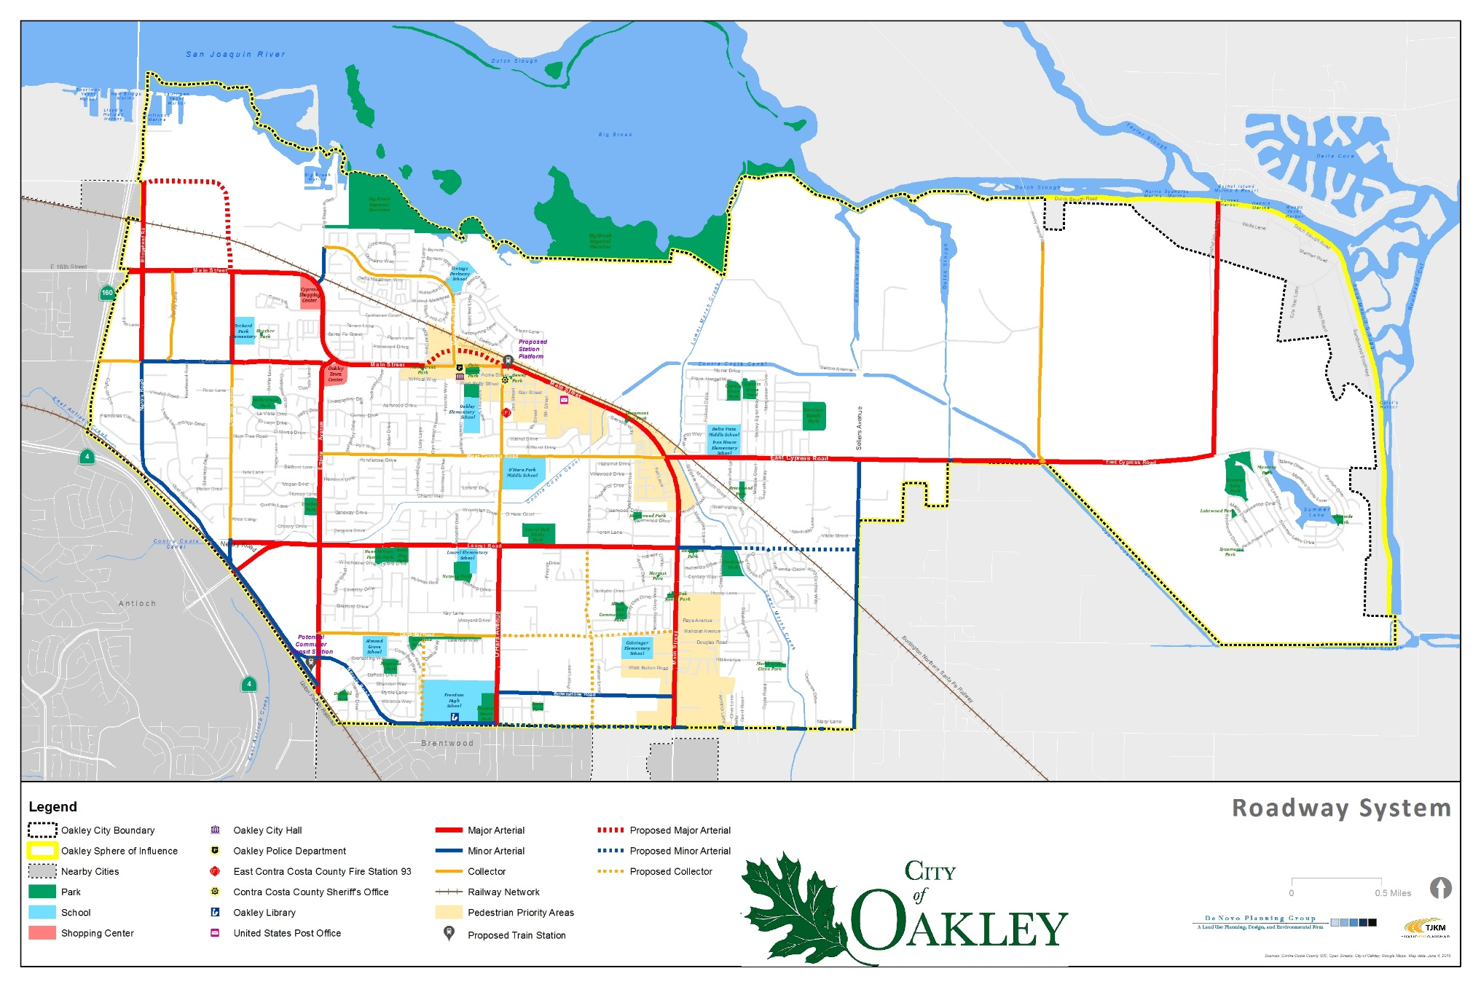
Circulation Diagrams
Roadway Network Plan
Arterial Streets
Collector Streets
Local Streets
Designated Truck Route Plan
Pedestrian and Bicycle Networks

Slide 7
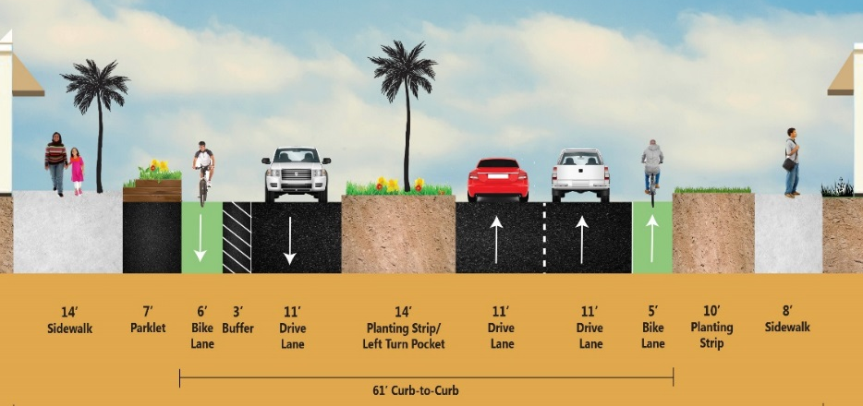
Street Classifications
Consider potential refinements to street classifications & standards to further incorporate complete street components

Slide 8
Vehicle Safety
Crash Severity | Total Crashes (2013-2017)
Fatal | 4
Severe Injury | 23
Visible Injury | 42
Complaint of Pain | 95
Property Damage Only | 376
Total | 540

Slide 9
Commute Characteristics
Jurisdiction | City of Oakley |  | Contra Costa County
Population | 39,950 |  | 1,123,678
Employed persons¹ | 18,071 |  | 520,162
Mode Split | Number | Percentage² | Number | Percentage
Drove Alone | 13,734 | 76% | 354,230 | 68%
Carpool | 2,422 | 13% | 60,859 | 12%
Public Transit | 506 | 3% | 53,577 | 10%
Walk | 126 | 1% | 8,843 | 2%
Bike | 72 | 0.4% | 2,601 | 1%
Other | 344 | 2% | 7,282 | 1%
Worked at Home | 867 | 5% | 32,770 | 6%

Slide 10
Travel Time to Work

Slide 11
Vehicle Miles Traveled
Vehicle miles traveled (VMT) is a common indicator used to quantify the amount of motor vehicle use in a specified area. SB 743 requires VMT to be used as the basis for evaluating transportation impacts relevant to environmental impact studies prepared for CEQA purposes effective July 2020.

Slide 12
Vehicle Miles Traveled
Prioritize spending across travel modes
Consider trip reduction and VMT incentives for new development
Jurisdiction | 2020 Estimate | 2040 Forecast
Bay Area (9 counties) | 15.1 | 14.3
Contra Costa County | 20.5 | 19.4
Eastern Contra Costa County | 20.2 | 19.1
Oakley | 23.0 | 21.3
Antioch | 20.6 | 19.7
Brentwood | 21.2 | 20.6
Pittsburg | 17.4 | 15.9

Slide 13
Community Input
Mobility Theme: Cars have traditionally been, and will continue to be a vital part of Oakley’s transportation network. Addressing traffic continue to be a priority. However, as the city continues to grow, additional emphasis needs to be placed on alternative ways of getting around, including walking, bicycling, and public transit. Increasing the safety and functionality of the entire circulation system is a high priority for the City.

Slide 14
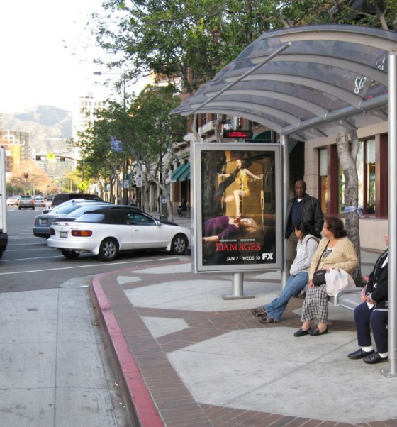
Community Input
Barriers to Mobility
Congestion in downtown
Safety concerns, including limited walkways for students near schools
Limited transit service, including near schools and downtown

Slide 15
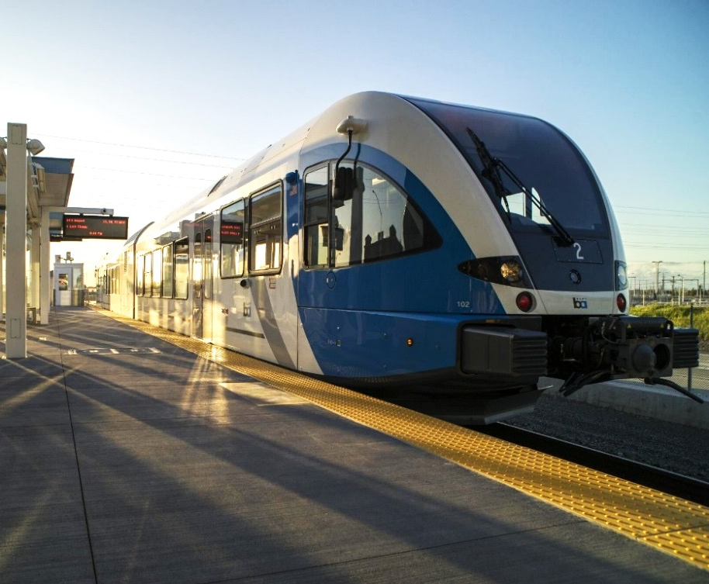
Community Input
Long-Term Vision & Top Priorities
Transportation safety
Provision of Active Transportation facilities including bicycle and pedestrian trails connecting major destinations, provision of “complete streets” and a walkable downtown.
Improved regional connectivity including improved access to BART/eBART and other transit facilities, and encouragement for expanding local transit operated by Tri Delta Transit and/or provision of Trolley/Shuttle services.
Improved access for all

Slide 16
General Plan Approach
Topic | Potential General Plan Policies and Actions
Vehicle Miles Traveled | Goal to reduce VMT on a per capita basis compared to existing per capita rates in Oakley Policy to guide evaluation of transportation impacts for CEQA purposes City can identify goal for reduction (e.g., 15%) Implementation Example: Future projects may demonstrate consistency with the 15% reduction goal through: 1) implementation of the TDM measures provided in the General Plan, 2) a project-based analysis that demonstrates a 15% reduction in existing VMT for the proposed land use(s), or 3) alternative methodology based on a regional plan or threshold (e.g., demonstration of consistency with a CCTA standard (if adopted in the future) that is supported by a CEQA analysis that the standard would achieve a less than significant impact associated with VMT. Projects assumed to be consistent with the 15% reduction and not require further analysis include: Small projects that generate or attract less than 110 daily trips (OPR Technical Advisory, p. 12). Land use projects proposed within ½-mile of an existing major transit stop or along an existing high quality transit corridor (CEQA Guidelines Section 15064.3).

Slide 17
General Plan Approach
Topic | Potential General Plan Policies and Actions
Complete Streets | Modify Goal 3.1 Roadways (“Provide an efficient and balanced transportation system”) and accompanying policies to include complete streets components. Provide policies and programs in support of Goal 3.1 that address all users, while continuing to recognize importance of motorized vehicle travel. Ensure policies and measures support a balanced transportation system. Update street design standards to accommodate all users and reduce conflicts between users
Safety | Refine safety goals and policies to address primary safety issues and concerns Consider a “vision zero” policy that would aim to eliminate fatalities attributable to collisions Ensure that street design standards promote desirable speeds and reduce conflicts between users
Level of Service | Continue to address level of service in roadway and project design to ensure adequacy of roadway system Review LOS goals to ensure that the goals complement Complete Streets goals and policies

Slide 18
General Plan Approach
Topic | Potential General Plan Policies and Actions
Pedestrian and Bicycle Travel | Adopt a Pedestrian and Bicycle Network Map Address as part of updated street design standards Ensure policies and measures support desired pedestrian and bicycle circulation system
Technologies | Address changing and emerging technologies, including electric vehicle charging stations, curb space management, changes in parking supply requirements, policies regarding electric scooter use and docking, and potential future technologies
Planned Improvements | Refine list of planned and desires improvements to reflect current and anticipated conditions and to support VMT and Complete Streets goals

Slide 19
General Plan Approach
Topic | Potential General Plan Policies and Actions
Environmental Justice | Update policies and plans to maximize the benefit to the public of new transportation technologies and services without adversely affecting the City’s transportation network. Consider implementing vehicle weight limit restrictions on roadways near sensitive uses like schools and residential neighborhoods to discourage cut-through truck traffic. Encourage and support local transit service providers to increase and expand services for people who are transit-dependent, including seniors, persons with mobility disabilities, and persons without regular access to automobiles, by improving connections to regional medical facilities, senior centers, and other support systems that serve residents and businesses. Review updates to transportation planning documents and any automated vehicle plans to ensure the benefits of automated mobility are equitably distributed across all segments of the community and that the negative impacts are not disproportionately borne on traditionally marginalized neighborhoods. As part of the development of or participation in any ridesharing program, including for shared automated vehicle fleets, ensure that the program considers the safety needs of vulnerable populations and loading needs of seniors, families with children, and individuals with mobility impairments.

Slide 20
General Plan Update Schedule
City Council Kick-off/Visioning Workshops
May/June 2019
Vision & Opportunities White Paper
August 2019
Vision: Overall Update White Paper/City Council Work Session #1
September 2019
Environmental Justice/Climate Change
White Paper/City Council Work Session #2
October 2019
Mobility
White Paper/City Council Work Session #3
January 2020
Admin. Draft General Plan
March/April 2020

