Slide 1
ARPA GRANT PROGRAM
INFORMATIONAL WORKSHOP | APRIL 21, 2022

Slide 2
BACKGROUND
Funds were designed to bolster agencies’ responses to the COVID-19 pandemic and its economic impacts by supporting the immediate pandemic response, bringing back jobs, and laying the groundwork for a strong and equitable recovery
ARPA Passed in 2021
Council allocated $180,000 to support nonprofits; awards up to $15,000

Slide 3
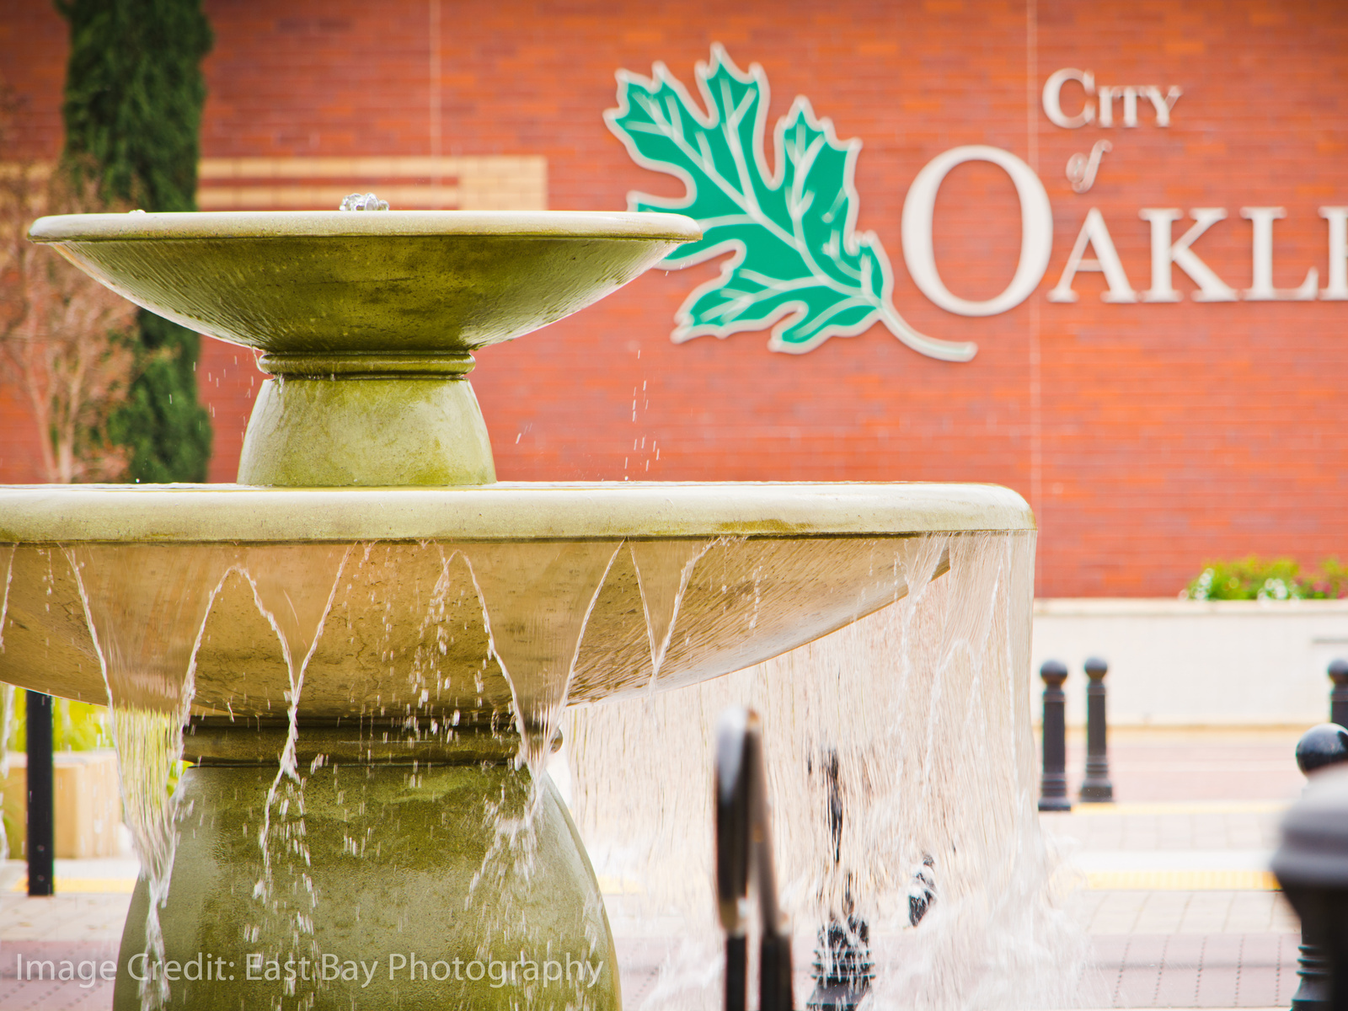
OBJECTIVES
Align to strategic priorities and address community needs
Support equitable outcomes for most impacted populations
Leverage and align with other funding sources
Make the best use of this one-time infusion of resources
Have a lasting impact

Slide 4
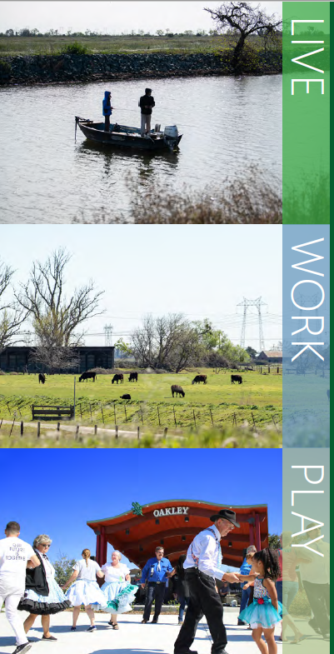
STRATEGIC PLAN
Mission
The City of Oakley will create a resilient future that fosters and attracts a vibrant and evolving community that welcomes and values all people.
Vision
The City of Oakley celebrates our unique Delta lifestyle and small-town feel where we Live in a safe, dynamic community, Work together to build the future, and Play in our own backyard.
Core Values
Our values will guide us on a PATH to where we want to Live, Work, and Play in the heart of the Delta.
• Promote fair and equitable stewardship for the welfare of our diverse individuals that comprise our inclusive community.
• Advocate a professional and family-friendly environment where Council, Staff, and the Public can envision and realize the City’s future together with a recognition of our shared commitments and opportunities.
• Transparency is how we will create accountable partnerships to cultivate communication and collaboration to engage our thriving community.
• Honesty and integrity are the foundation for building trust and fostering teamwork to live our mission and vision.

Slide 5
STRATEGIC PLAN
Community & Economic Development Goal: The City will inspire and encourage Community & Economic Development through strategic and thoughtful growth, a business-friendly environment, and local employment opportunities.
Community Health & Safety Goal: The City of Oakley will protect our public and prioritize safe streets, healthy neighborhoods, and robust community resources to benefit our most valued assets -- our people.
Parks and Open Space Goal: The City of Oakley will capitalize on our greatest Delta asset where our residents, businesses, and visitors can recreate and relax.
Community and Collaborative Partnerships Goal: The City of Oakley will build strong community and collaborative partnerships to be mutually beneficial and co-create shared goals.
Finance and Fiscal Responsibility Goal: The City of Oakley will leverage its financial resources for the long-term benefit of our residents and businesses while maintaining sufficient reserves to provide stability and ensure a successful future.
Sustainable Organization Goal: The City of Oakley will create a vibrant municipal workforce that reflects our commitment to an inclusive and equitable community and can meet our mission today while striving for our envisioned future tomorrow.

Slide 6
TENTATIVE TIMELINE
Opening of Applications
April 11th
Informational Workshop
April 21st
Final Date for General Questions
May 17th
Deadline for Submission
May 19th at noon
Review and Evaluation Process
May 23 - June 3
Recommendations to City Council
June 14th
Grant Agreements Effective
July 1st

Slide 7
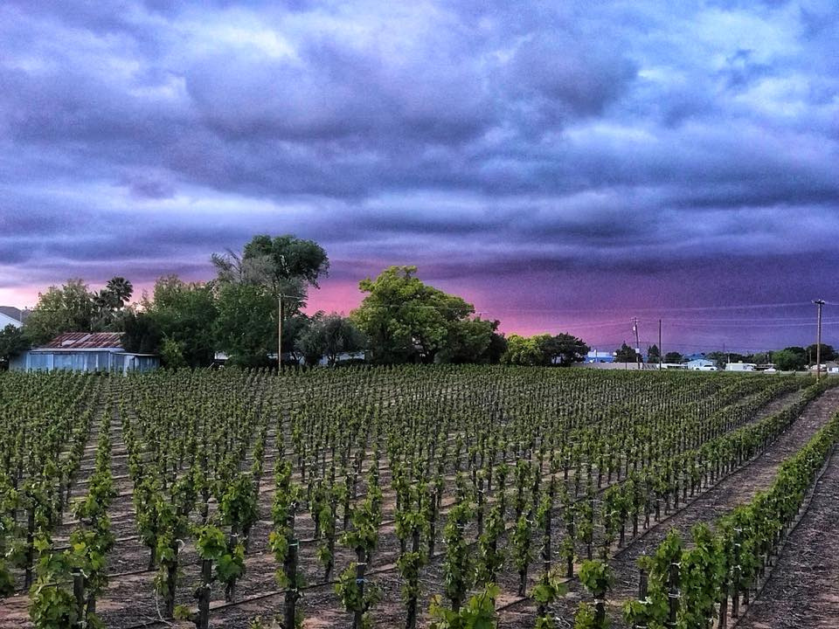
ELIGIBILITY
Responsive Application
Recognized 501(c)3
Serve Oakley community
Up to date filings
Able to administer funds
Agreeable to Agreement form

Slide 8
PROPOSAL REQUIREMENTS

Slide 9
1
General Information
APPLICATION SECTIONS
2
Project Description
3
Community Benefits
4
Budget Narrative & Organizational Capacity
5
Attachments: Budget & Nonprofit Status

Slide 10
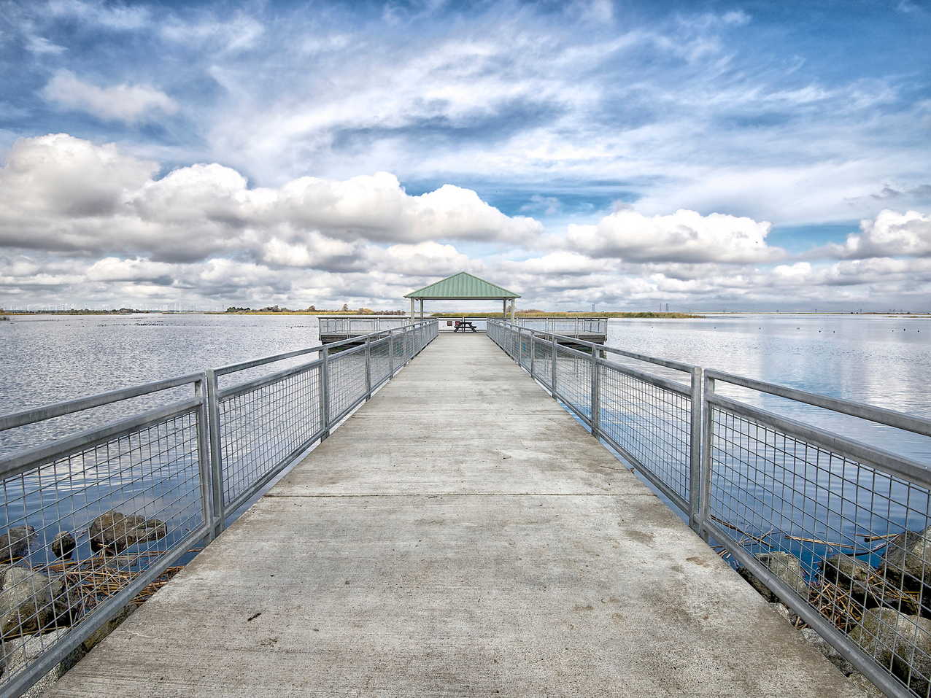
SELECTION PROCESS & CRITERIA

Slide 11
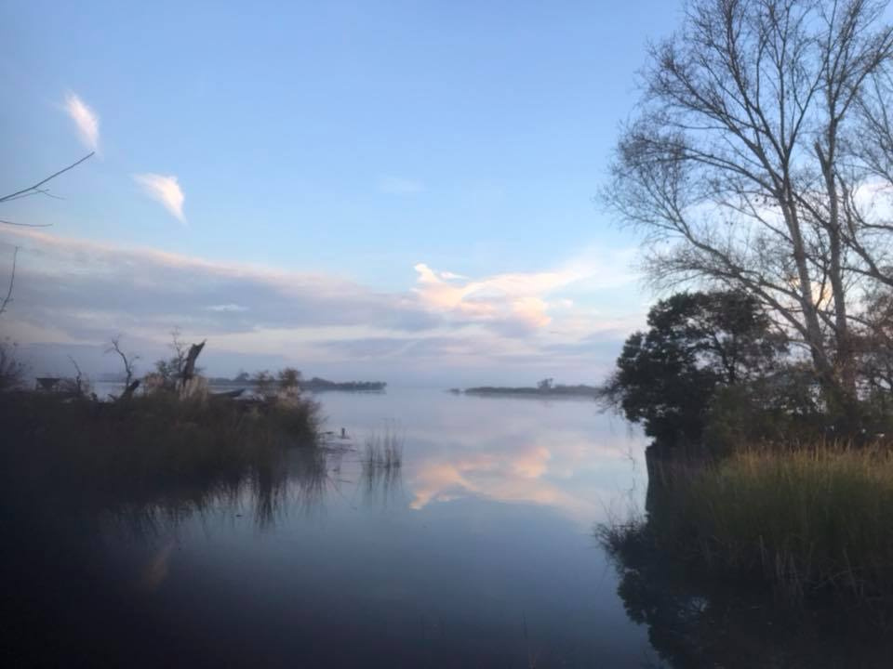
MINIMUM CRITERIA
Tangible impact
Long-term impact
Community need
Alignment
Leveraging
Efficiency
Transformative change
Organizational capacity

Slide 12
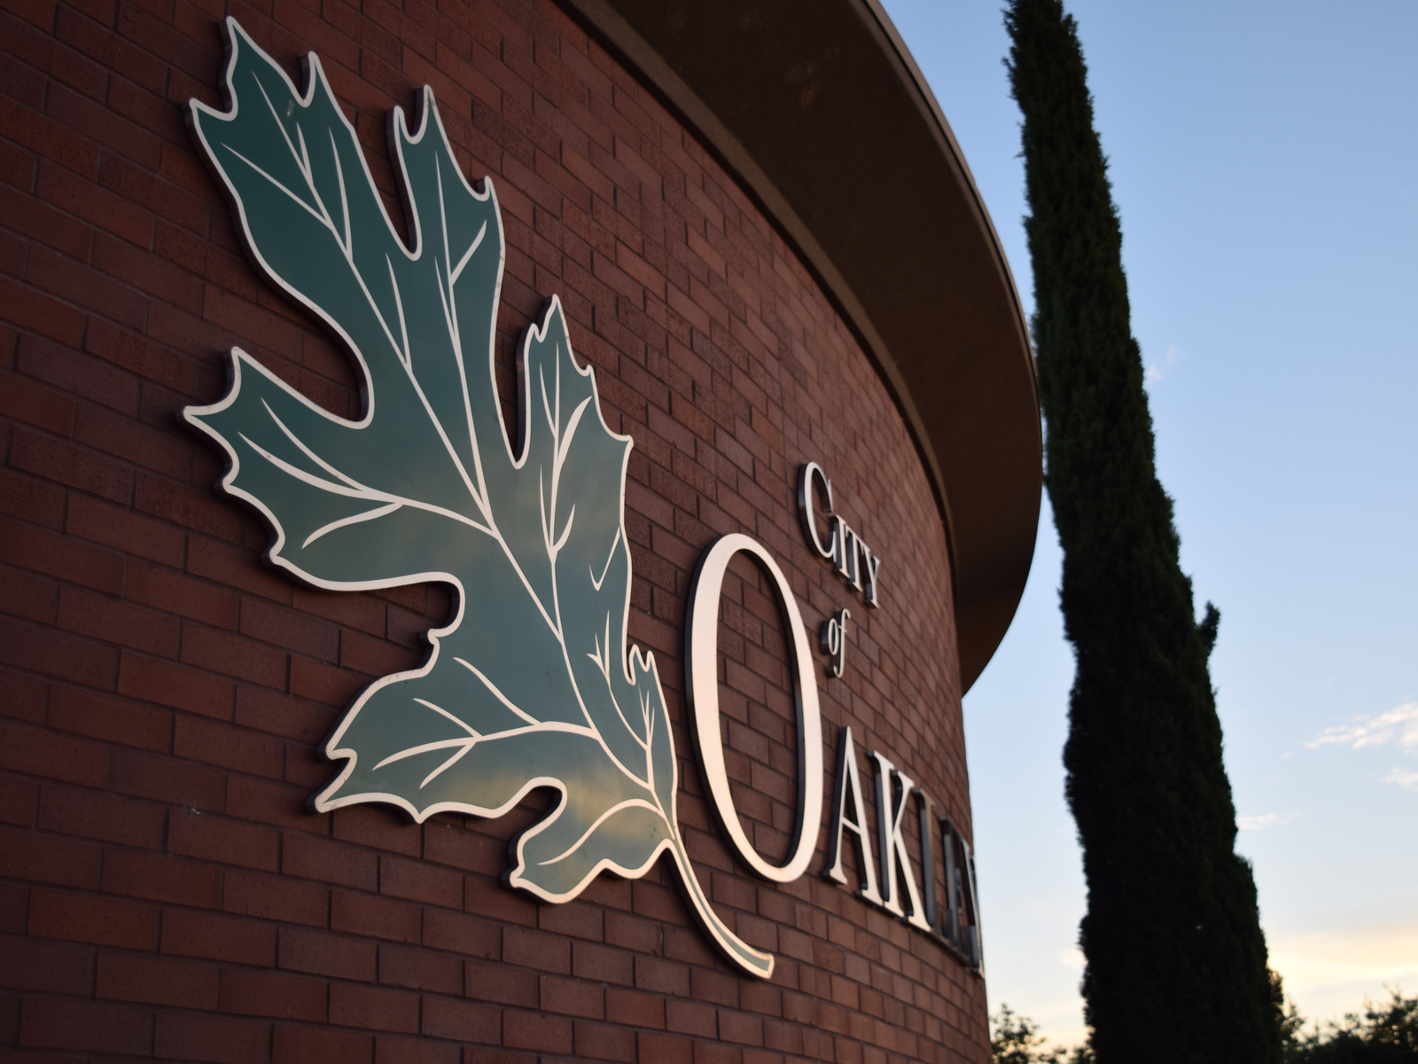
QUESTIONS?
Felicia Escover
escover@ci.oakley.ca.us
(925) 625-7162

